Slide 1
DATA INTEGRATION AND PROCESSING
Nelly Selem (Secodment host)
Jeanett Daga (Secodment)

Slide 2
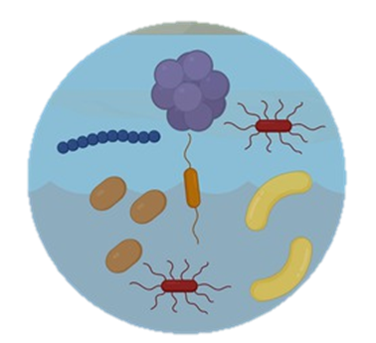







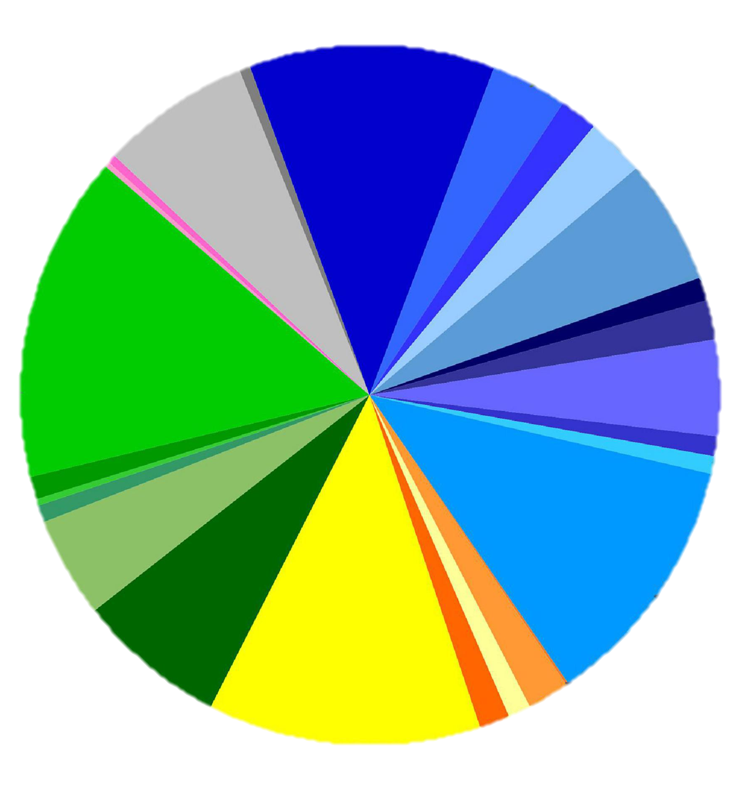
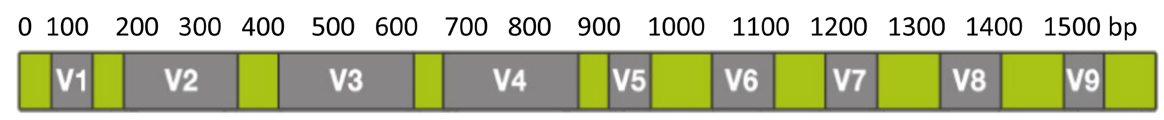
METAGENOMICS
Amplicon sequencing
Shotgun sequencing
DATA BASES
NCBI, GreenGenes, myRDP, Silva
DNA extraction
16S rRNA
18S rRNA
ITS1
rRNA complete operon
Genome assembly
Taxonomic diversity
Sequencing
Taxonomic profiling
Structural identification
Metabacording
Whole genome
Detection of potential gene functions
Representation of evolutionary relationships
Raw reads

Slide 3
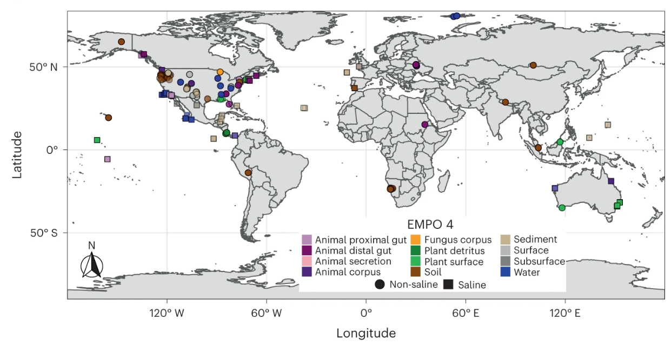
Earth Microbiome Project 500 (EMP500)
Total samples (n = 880)
To study the taxa and metabolites within microbial communities from diverse habitats across Earth
microbial and chemical ecology
Methods for multi-omics microbiome studies of hosts and the environment.
Shaffer, J.P., Nothias, LF., Thompson, L.R. et al. Standardized multi-omics of Earth’s microbiomes reveals microbial and metabolite diversity. Nat Microbiol 7, 2128–2150 (2022). https://doi.org/10.1038/s41564-022-01266-x

Slide 4
DATA OBTAINED
Amplicon
16s.biom
16s.fa
16s.nwk
16s.tax
Subset
16s.biom
16s_labeled.nwk
16s.nwk
Shotgun
ec.biom
ko.biom
ogu.biom
ogu.nwk
pathway.biom
ogu.info
ogu.tax
ko.name
pathway.name
Assembly
bagel_bacteriocins_all_classes.csv
mag.biom
pdb_hits.fa fasta
mag.tax
prokka
Masspec
canopus.tsv
fbmn.tsv
is.microbial
lcms.biom

Slide 5
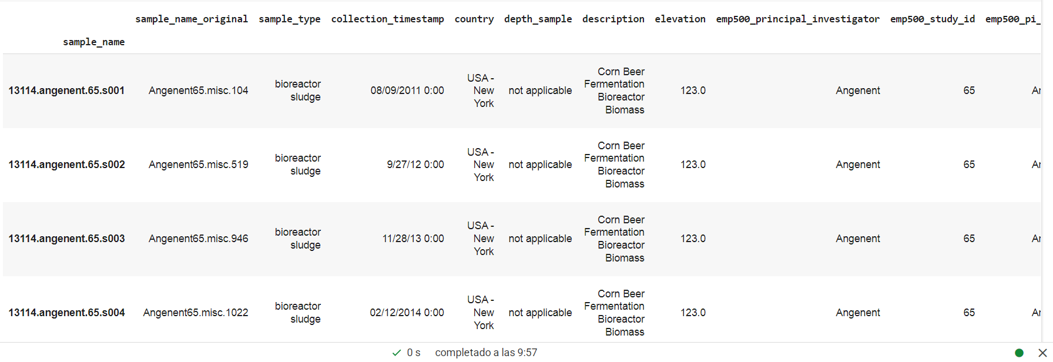
Metadata.tsv

Slide 6
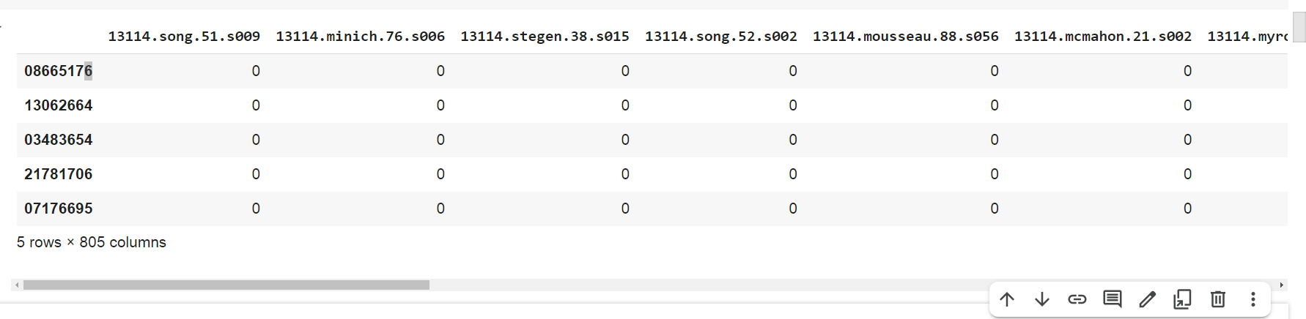
file.biom

Slide 7
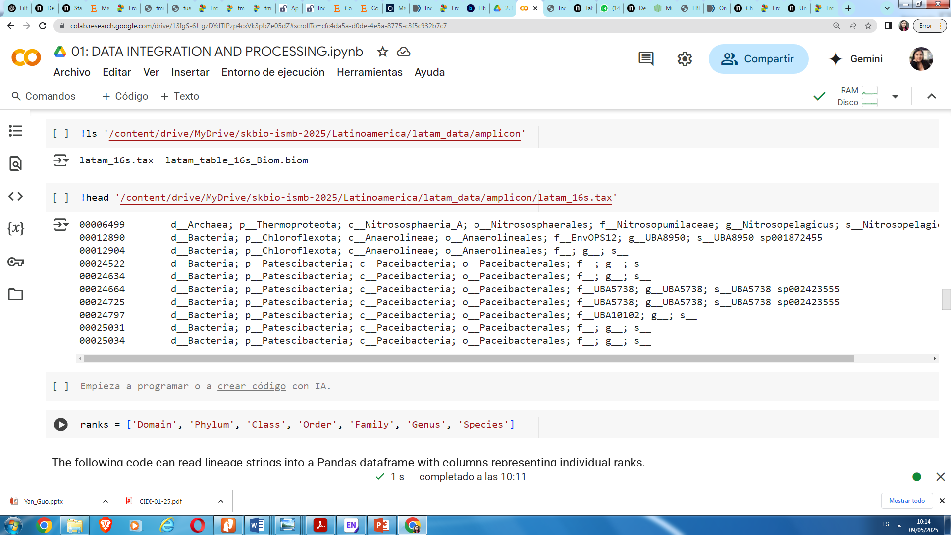
File.tax

